Slide 1
Architecture Design

Slide 2
SA Design Reference Model
A general framework for organizing design activities – modify to fit methodology
Start with requirements (FR, NFR, UC)
Defines the problem space
  e.g. tuition payment system
Find architecture drivers
  Business goals
  Important quality attributes
  High-risk / complex FR
  e.g.
  Security (money)
  Reliability (money)
  Performance (quality perception)
  Scalability (a lot of students)
traceability, not process flow
Requirements:
Domain functions
Quality attributes
Use cases
Architecture Design Documentation
Architecture
Drivers
Subset
(ASRs/QAs)
Module
Decomposition
Design
Design
Decision
Analysis
Quality
Attribute
Scenarios
Architecture
Pattern
“Catalog”
Pattern and
Design Tactics
Selection

Slide 3
Attribute Driven Design
Quality attribute scenarios drive pattern/tactic selection and decomposition
The result is verified through design decision analysis
The process repeats until all ASRs are satisfied
Requirements:
Domain functions
Quality attributes
Use cases
Architecture Design Documentation
Architecture
Drivers
Subset
(ASRs/QAs)
Module
Decomposition
Design
Design
Decision
Analysis
Quality
Attribute
Scenarios
Architecture
Pattern
“Catalog”
Pattern and
Design Tactics
Selection

Slide 4
Attribute Driven Design (ADD)
The SA Design Reference Model formalizes as ADD (Bass, Clements & Kazman – SAiP Ch. 20):
  Step 1: Choose a system element to design
  Step 2: Identify ASRs – write quality attribute scenarios
  Step 3: Generate a design solution – patterns, tactics, module decomposition
  Step 4: Verify – analyze decisions, check ASR satisfaction
  Step 5: Repeat until all ASRs are satisfied

Slide 5
ADD Step 2: Define Attribute Scenarios
Define attribute scenarios
  Source
  Stimulus
  Artifact
  Environment
  Response
  Measure
e.g.
  Source: Students
  Stimulus: Payment request submitted
  Artifact: Payment service
  Environment: Peak load (500 simultaneous users)
  Response: Processes all payments
  Measure: Within 2 sec for 95%
Result: concrete, testable quality requirements

Slide 6
ADD Step 3: Design Solution
Patterns & tactics satisfy QA scenarios; apply with FRs to decompose into services
  Patterns: reusable structural solutions
  Tactics: design decisions for a specific QA
e.g.
  Decomposition → microservices (pattern)
  Performance → caching (tactic)
  Security → input validation (tactic)
  Availability → Replication, Heartbeat, Failover
Example: Payment, Auth, SMS & Email services
  Non-linear: SMS & Email both needed retry logic → merged into one messaging service

Slide 7
ADD Step 3: Decision Catalog Checklist
What must be decided for each QA tactic choice:
Allocation of responsibilities | What each module is responsible for (functionally and non-functionally) e.g. AuthService – login (FR) and password policy (NFR)
Coordination model | How modules interact – interfaces, protocols, control flow e.g. REST between FE & BE, event bus between services (concern: async vs sync)
Data model | How data is abstracted, represented & organized e.g. normalized SQL + cache for reads (concern: consistency vs performance)
Resource management | How shared resources (HW/SW) are allocated & utilized e.g. limit concurrent GPU jobs per user (concern: latency, throughput, fairness)
Architecture element mapping | Mapping of modules to physical resources e.g. Docker/k8s vs Lambda + SNS (concern: performance vs cost vs complexity)
Bind time decisions | Trade-offs across development, deployment & runtime e.g. feature flags vs hardcoded config (concern: maintainability)
Technology choices | Hardware, software & tooling choices e.g. Java+Spring vs Node+React; Docker, Terraform (concern: team expertise, cost, ecosystem)
Notes:
Sync – simple, async – scalable
DM, also – spread entity across microservices (consistency)
RM – shared & underutilized (functionality overlap)

Slide 8
ADD Step 4: Justify & Check Decisions
Justify decisions, then verify they hold up
  What are the alternatives, and their pros & cons?
  What is the impact on QAs — why was this option chosen?
  Do the selected patterns & tactics actually satisfy the ASRs?
    Watch for automatic, habitual choices
  Are there conflicts between decisions?
    e.g. Cache improves performance but decreases consistency
  Are trade-offs truly justified?
    e.g. Async messaging chosen for scalability — but does throughput actually require it?
  Refine if insufficient: change tactics, restructure modules, or remap responsibilities
Document your reasoning!

Slide 9
ADD Step 4: Quantitative vs. Qualitative Analysis
Analyze design decisions
  Quantitative analysis
    Models & experiments
    e.g. performance – response time estimations
    e.g. availability – single points of failure, how many instances can go down
    e.g. cost – resource utilization, cost projection (S3 vs GPUs)
  Qualitative analysis
    Hard to calculate
    e.g. modifiability, maintainability, security
    Scenario walkthroughs – trace each QA scenario through the design
      Does the architecture respond correctly to each stimulus?
    Expert / peer reviews
  Architecture decisions should be defensible & traceable to requirements

Slide 10
ADD Step 5: Document, Iterate, Repeat
Document, iterate & repeat
  Documenting
    Include views, e.g.
      Module view – system decomposition
      Component & connector view – runtime execution & communications
      Allocation view – mapping to physical resources
  Iterative process
  Recursive decomposition
    For the system → for each component
  Victory
    ASRs are met
    Out of money & time -> sort it out during construction

Slide 11
Functionality-Based Architectural Design
Functionality-based design jumps straight from requirements to Module Decomposition
Design Decision Analysis then tests the result against Quality Attribute Scenarios — assessing quality afterward, instead of using it to drive the decomposition upfront like ADD does
If issues surface, Pattern & Design Tactics Selection is revisited to transform the design (red)
If no issues surface, the Architecture Design Documentation is updated (blue)
The process repeats until all ASRs are satisfied
Requirements:
Domain functions
Quality attributes
Use cases
Architecture Design Documentation
Module
Decomposition
Design
Design
Decision
Analysis
Pass
Quality
Attribute
Scenarios
Test
Fail
Architecture
Pattern
“Catalog”
Pattern and
Design Tactics
Selection

Slide 12
Functionality-Based Architectural Design
Starting from functional requirements …
Define system context
  Identify
    Actors (users, external systems)
    Protocols
    Data exchange
  (maybe) Draw a context diagram
Identify subsystems (first-order functional abstractions)
  Not modules!
  e.g., Identity & Access, Enrollment, Billing, Notifications, etc
Decompose into modules (second-order functional abstractions)
  Define responsibilities & interfaces
Describe in system views
Output artifact is the application architecture
Abstraction
Detail

Slide 13
Estimate Quality Attributes
Will the architecture fulfill the quality attribute requirements?
Actual values can’t be measured yet…
  “Formal” architecture analysis techniques
    Architecture Tradeoff Analysis Method (ATAM) (coming soon…)
  Simulation – build
    Skeleton of the entire system
    Or prototype parts to execute scenarios
      e.g. want to evaluate async communications between 2 services
    Mock external services to simulate events (failure, delays, etc)

Slide 14
Estimate Quality Attributes
Will the architecture fulfill the quality attribute requirements?
Actual values can’t be measured yet…
  Quantitative (mathematical) modeling of scenarios
    e.g. queuing network theory
  Qualitative experience-based assessment
    e.g. architecture review board, expert walkthrough
In practice use more than one method

Slide 15
Architecture Transformation
Compare evaluation estimates to requirements
If requirements not satisfied (likely), the architecture (or its context) must be changed
Apply two or more architecture transformation methods:
  Replace architectural patterns & tactics – unacceptable trade-offs
  Add architectural patterns & tactics – mitigate trade-offs → maybe new trade-offs
  Convert quality requirements to functionality
    e.g. reliability → add exception handling & transaction rollbacks
    e.g. security → add audit logging & MFA
  Rebalance quality requirements between subsystems
    e.g. 99.99% availability for transaction processing & 95% for reporting
Reevaluate the transformed architecture against functional and quality requirements

Slide 16
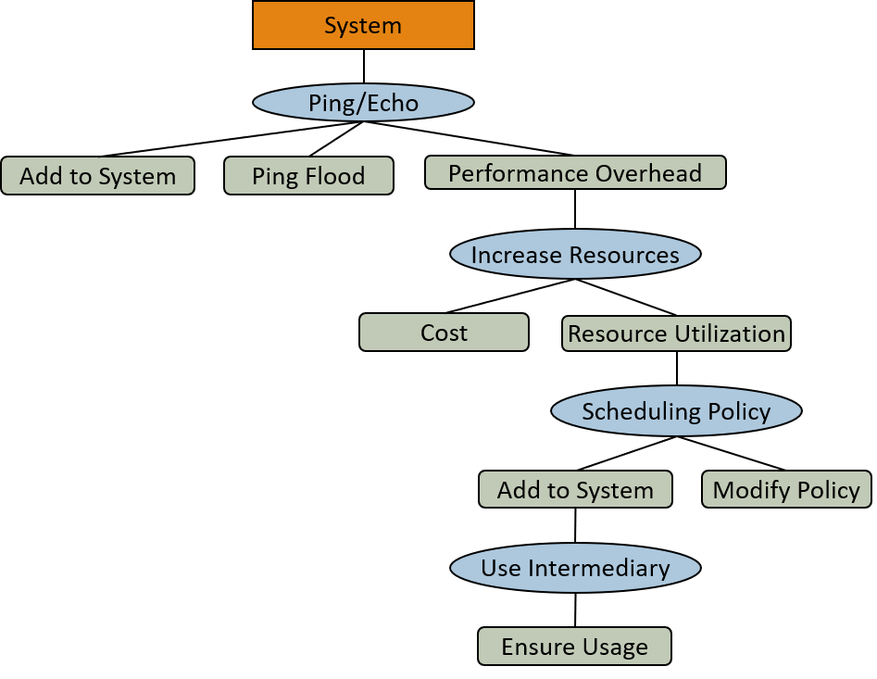
Issues
QAs can be in conflict – trade-offs
  Examples?
Complexity – simple designs may blow up in complexity to support QAs
  Performance → caching (& invalidation)
  Availability → Circuit breaker
  Observability → Tracing, side cars, metrics
  Security -> MFA, encryption, audit logs, minimal trust, rotated creds, etc
  Lose conceptual understanding
    → hard to maintain
    → costs more
QA estimates are estimates (may be incorrect)
  → can lead to wrong decisions
  The only real validation is the final system
Notes:
QA Conflicts:
Accuracy and Speed (quantization);
Usability and Security;
Modifiability and Performance (more components more interfaces more overhead)

Slide 17
Foundational Architecture Design Techniques
Fundamental Principles
Unit Operations

Slide 18
Some Historical Perspective
1960’s: good design practices introduced out of necessity
  Cannot understand 100,000s of lines of code at once (IBM/360, NASA, etc)
  e.g. NASA’s Apollo guidance software – one of the first strict modularizations
1970’s: codifying what programmers were doing intuitively
  Fred Brooks – The Mythical Man-Month, 1975
  Edsger Dijkstra – Structured Programming, 1972
  David Parnas – On the Criteria to Be Used in Decomposing System into Modules, 1972
  etc
1980’s: OOP gains traction (invented in 60s)
  Incorporated encapsulation, inheritance, polymorphism

Slide 19
Some Historical Perspective
1980-90’s: distributed system emerged
  Transfer from the module level design to the architecture level
  How we code? → how components collaborate?
1990’s: architecture is formalized
  Patterns – Layered, Client-Server, Pipe-and-Filter, etc
  Quality attributes – performance, security, etc
  Architectural views – module, allocation, etc
  Intuition → Principles → Method
2000s: architectural principles are evolving
  Component-based design
  Service-oriented architecture
  QAs explicitly guide design choices
  New tactics are codified

Slide 20
Some Historical Perspective
2010’s: microservices and evolutionary architecture
  Cloud computing & containers → increased delivery pace
  Architecture is not static anymore
  Classical principles are reused
    Information hiding → bounded context
    Encapsulation → container isolation
    Integrity → API contracts
  New patterns and tactics – event-driven, CQRS, etc
2020’s: architecture focus shift
  Adaptability – adjust fast in the CD world
  Observability – tracing & metric are first-class design artifacts
  Resilience – chaos engineering, self-healing systems
  Started earlier, but gained traction

Slide 21
Fundamental Principles and Techniques of Software Construction
Abstraction | Define conceptual boundaries Hide complexity by exposing only essential behavior
Separation of Concerns | Separate different or unrelated responsibilities e.g. Presentation / Business Logic / Data Access
Modularization | Packaging of entities that form the logical structure of a system – modules e.g. AuthService, NotificationService
Information Hiding | Conceal module design details from its clients e.g., ArrayList vs LinkedList – add(), remove() → modifiability & stability
Encapsulation | Group the elements of an abstraction that constitute its structure and behavior Prevents illegal state change (DB and microservice)
Coupling and Cohesion | Inter- and intra-module dependency strength Target – low coupling, high cohesion

Slide 22
Fundamental Principles and Techniques of Software Construction
Sufficiency, Completeness and Primitiveness | Satisfy minimum and necessary requirements as atomic operations Sufficiency – provide all what needed Completeness – nothing required is missing Primitiveness – provide simple operations (Unix way)
Separation of Policy and Implementation | Separate rules from implementation Policy – password should be rotated every 90 days Implementation – function Policy change should not lead to redeployment (e.g., DB config)
Separation of Interface and Implementation | Separation of the declaration of functionality from its realization e.g. Set → HashSet / TreeSet e.g. BankClient → BOAClient / ChaseClient
Single Point of Reference | Declare and define a module only once to avoid inconsistency No multiple sources of truth

Slide 23
Software Partitioning Strategies – Separation of Concerns
Isolate – keep independent from the rest
  Hardware
    System should not be rewritten if there is different HW
  Time critical components
    Should not be affected by anything
    Separate component, HW, real-time OS…
    e.g. autonomous vehicle – collision avoidance isolated from navigation & infotainment
  Configuration data
    Storage limits, DB URL, rules, etc
  External interfaces
    Payment provider API, DB, message broker, etc
    Integration layer / class
Separate – group by cohesion
  Logically cohesive domain functionality
    e.g. enrollment service, payment service, tuition calculator, etc
    Decreases coupling, increases cohesion
  Human computer interface from domain model
    Allows modification of both independently
    Allows multiple HCIs
  Main functions from utility functions (cross cutting concerns)
    e.g. logging, metrics, configuration, authorization, etc
    Is not a part of main functionality
    Inject / import / aspects / side cars
    Easier to maintain both separately

Slide 24
Modularity and Software Cost
Cost to integrate
Too few modules (monolith) → high per-module complexity
Too many (nano-services) → integration cost dominates
Aim for the balance
Optimal granularity depends on team size, deployment model, and communication overhead
Region of minimum cost
Cost of Effort
Cost/module
Number of Modules

Slide 25
Software Changeability and
Dependency Management
Stable dependencies principle (SDP):
  “Depend in the direction of stability” – modules should only depend on modules that are more stable than it is
  Stable:
    Many dependencies (hard to change)
    Changes rarely
    Exposes an interface, not implementation
Acyclic Dependencies Principle
  “Dependency structure for released components must be a directed acyclic graph” – no cycles in the dependency structure
Interface Segregation Principle
  Clients should not be forced to implement interfaces they don’t use
    → decompose the interface → clients only depend on what they use → lower coupling
Notes:
SDP: If you build on top of quicksand, your castle will sink
Interface Segregation Principle: If you are only using public APIs, don’t be forced to implement OAuth

Slide 26
Integration Strategies
How will components communicate? (ADD: Coordination Model decision)
  e.g. box solutions or legacy systems, major internal subsystems
  Integration approach: build-time linking / load-time libs / runtime API calls
Data-only integration (lower level of abstraction)
  e.g.
    Payroll system exports CSV files
    Accounting system consumes the files & processes them
  Loose coupling through data exchange
    Best for: batch processing, legacy/heterogeneous systems, decoupling is priority
  Downsides – manual user intervention may be required, may be slow
Executable integration (higher level of abstraction)
  Components call each other directly via interfaces or protocols
    e.g. chat-bot service calls OpenAI API via HTTPS; service-to-service REST calls
  Best for: real-time requirements, shared business logic, tight coordination
  Downsides – tighter coupling, availability dependency, versioning overhead
Notes:
What about message buses or queues?

Slide 27
Unit Operations
Like primitives in a language – each does one thing; combine them to form patterns
  e.g. Part-whole + Abstraction → Layered Architecture; Replication + Abstraction → Load Balancer
Part-whole decomposition
Replication
break a whole into bounded parts
e.g. web app → frontend / backend / db
Is-a decomposition
organize by subtype relationships
e.g. BOAClient is-a BankClient; AuthService is-a Service
duplicate a component for availability or load
e.g. database replicas, load-balanced stateless services
Abstraction
Compression (Consolidation)
Resource Sharing
expose interface, hide implementation
e.g. PaymentGateway interface hiding Stripe / PayPal specifics
merge logically related elements into one
e.g. SMS + email → single NotificationService (shared retry logic)
components share a single resource
e.g. connection pool, API gateway

Slide 28
Software Architecture Design Example
Using Attribute Driven Design

Slide 29
Garage Door Example
Design a product line architecture for a garage door opener integrated with a home information system
  Raise/lower door via switch, remote, home info system
  Problem diagnosis from home information system
  Ensure safety protocols are implemented
Diagnostics
Alerts
Home Info Sys
Garage Door Opener
Sensor/
Actuator
Control
Control
Control
Remote

Slide 30
Step 1: Choose a System Element to Design
For new (green field) systems it is the whole system
For legacy, what is being added
After the first iteration what comes next, element breadth or depth?
  Depth if there are technology risks or resourcing concerns
  Breadth if a system-wide overview is needed before specializing
Our example: Garage door opener — green field, so we start with the whole system

Slide 31
Step 2: Identify the ASRs
Start with quality scenarios
  Device and controls differ for various products in product line
  Product processors differ
  Garage door descent must stop within 0.1 second after obstacle detection
  Access to opener from home info system for control and diagnostics with proprietary protocol
  ASRs are a combination of functional requirements, constraints, and quality attributes
  Prioritize ASRs and select those that will “drive“ the architecture design
  Garage door system:
  Real-time performance
  Modifiability to support the product line
  Interoperability for online control and diagnostics

Slide 32
Step 3: Generate a Design Solution
For the Chosen Element
Goal: establish an overall architecture design that satisfies architectural drivers
For each ASR for this element choose a design solution …
The patterns, tactics, design principles to achieve quality attributes
Watch for QA design tradeoffs between tactics
Performance
  Real-time constraints on safety-critical computations
  Need tactics to deal with the control of resource demand and resource management
  Choose "increase resource efficiency" and "schedule resources"
  Design decision: separate critical and non-critical performance computation
It’s possible the domain problem may call for a “custom” architecture pattern

Slide 33
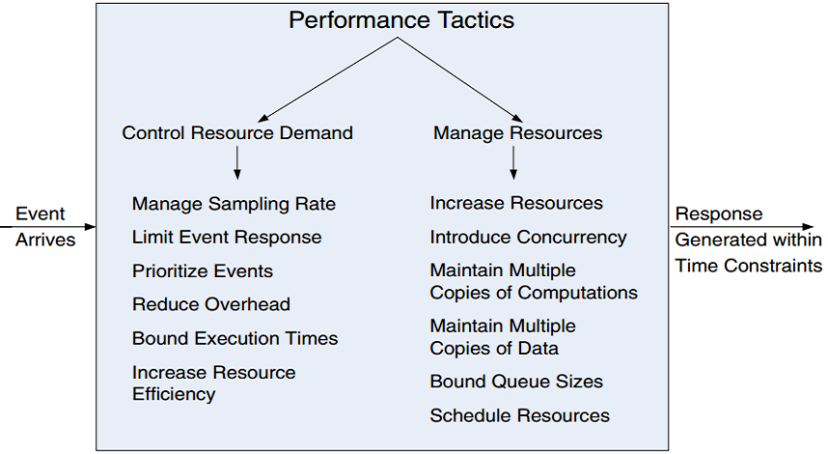
Performance Tactics
Critical
computation
runs fast
Critical ops preempt non-critical work when stimulus arrives
Together: neither tactic alone guarantees the ≤0.1s door-stop response — you need both fast execution AND guaranteed scheduling

Slide 34
Step 3: Generate a Design Solution For Another Chosen Element
Modifiability
  Primarily concerned with changes at build time, not runtime
  Need tactics to support separation of responsibilities to localize changes
    Increase cohesion, reduce coupling
  Choose “increase semantic coherence”, “encapsulation”, and “abstract common services” as our tactics
  Design decision: separate responsibilities dealing with the user interface, communication, and sensors into their own modules

Slide 35
Modifiability Tactics
Hide internals — callers unaffected by implementation changes
Group related responsibilities — changes stay within one module
Shared interface — one change point for all callers
Together: UI, communication, and sensor modules change independently — supports product line variants

Slide 36
Step 3 Result: Pattern for Garage Door Opener
Design rationale
Performance ASR:
Perf-Critical Comp. → resource efficiency tactic
Schedule that Guarantees Deadlines → schedule resources tactic
Modifiability ASR:
UI + Non-Perf-Critical + VM → separate responsibilities
Legend:
——► depends on
User Interface
Non-Performance-
Critical Computation
Performance-Critical
Computation
Virtual
Machine
Schedule that
Guarantees Deadlines

Slide 37
Step 4: Validate Design and Refine Requirements
Test the element design for requirements satisfaction
Requirements satisfied | Done, no more refinement
Requirements not fully satisfied | Defer to the next iteration Delegate or distribute requirement satisfaction to sub-module elements
Requirements cannot be satisfied with this design | Revisit the design - backtrack Previous designs become a constraint – account for them before backtracking Negotiate the ASR with stakeholders
If not fully satisfied, apply targeted remediation
ASRs Not Met | Action
Quality attribute | Apply tactics to address the trade-off
Functional responsibility | Add responsibilities to existing module Create new module
Constraint | Modify the design Relax the constraint

Slide 38
Step 5: Repeat Until all ASRs Have Been Satisfied
If all ASRs satisfied, done – a workable architecture
  Or elaborated sufficiently for construction
  (or you run out of time and money)
Otherwise …
  Repeat step 1 – choose the next (sub)element(s) to design
    e.g., garage door opener: Performance & Modifiability ASRs satisfied; next iteration addresses Interoperability ASR
  Repeat steps 2-4
  As necessary refine use cases and QA scenarios as ASRs for the next design iteration

Slide 39
Are the ASRs Satisfied?
Or is the Design Sufficient?
Modifiability ASR – ✓ Satisfied
  Device and controls differ for various products in product line
  Product processors differ
Performance ASR – ✓ Satisfied
  Garage door descent must stop within 0.1 second after obstacle detection
Interoperability ASR – Next Iteration
  Access to opener from home info system for control and diagnostics with proprietary protocol

Slide 40
Next Iteration Decomposition
Step 3, Iteration 2 – define sub-modules, assign functionality
Virtual Machine Module
  Sensors/actuators VM – standardizes hardware device interfaces
  Communications VM – standardizes network/protocol interfaces
Non-Performance-Critical Module
  Diagnostics and normal door raising/lowering sub-modules
Performance-Critical Module
  Obstacle detection and door halting functions
Connections
  VM sub-modules expose standardized interfaces upward to functional modules
  Performance-critical sub-module depends on Schedule that Guarantees Deadlines

Slide 41
Iteration 2 Module View
User Interface
Diagnose
Raising/Lowering
Door
Obstacle
Detection
Home Info System
Communication
Virtual Machine
Sensor/Actuator
Virtual Machine
Scheduler that
Guarantees
Deadlines

Slide 42
Let's design the HC system
Users Register
Users select Health plan
  Online
  By Mail
  By phone

